Slide 1
SKILL SEEKER
Project plan for the Initiation phase

Slide 2
TABLE OF CONTENTS
01
02
03
06
04
05
Business case
Background
Deliverables
Information and reporting
Planning
Scope and risk management
07
The team

Slide 3
01
Background

Slide 4

Background
The company:
Mediaan.com
Sales department
IT and consultancy company
Reason for project
Streamline the process of assigning developers to projects. Current way is too slow.

Slide 5
02
Deliverables

Slide 6
Deliverables
Application which will recommend employees based on the skills required by the given project
Easy to use application
Documentation and user manual

Slide 7
03
Business case

Slide 8

Efficient Resource Allocation

Slide 9

Increased Employee Productivity

Slide 10

Skill Development and Utilization

Slide 11
04
Planning

Slide 12
Planning
Phase 1: Researching possibilities and technologies
Deadline: March 8th, 2024
Phase 2: Realization
Deadline: May 24th, 2024
Phase 3: Information & Reporting
Deadline: May 31st, 2024

Slide 13
Phase 1
Market research for existing solutions
Research for technology to be used
Tech stack
DBMS
Create wireframes
Define functional must have requirements
Design data model
Deadline: March 8th, 2024

Slide 14
Phase 2
Creation of database
Creation of front-end
3 sections
Login page
Employee
Employee list page
Employee details page
Project
Project list page
Project details page
Creation of back-end
Hosting application
Deadline: May 24th, 2024

Slide 15
Phase 3: Information and Reporting
Finalize documentation
Prepare final presentation for client
Deadline May 31st, 2024

Slide 16
05
Scope and risk management

Slide 17
Out of scope
In scope
Filtering employees based on skill set.
Filtering employees based on name.
Skill matrix for better matching.
Employees can edit their own information.
Admin can edit anyone's information.
Integrating Azure AD.
Tailor made CV generation.
Personal development trajectory.
Matching with the usage of AI.
Adding new skills.
Editing relationship score between skills.

Slide 18
Risk analysis and measures
Miscommunication:
Little communication with client
Solution: Intermediate alignment meetings
User adoption:
Sales department employees not adopting the new system
Solution: Give proper training after the application is finished

Slide 19
06
Information and Reporting

Slide 20
Information and Reporting
Intermediate alignment meeting
Review of current state at the time.
Share insights .
Final reporting
Location: Mediaan Hasselt.
Presentation of final product.
Deliver reports/documentation.
Final reporting: May 31st, 2024

Slide 21
07
The Team

Slide 22
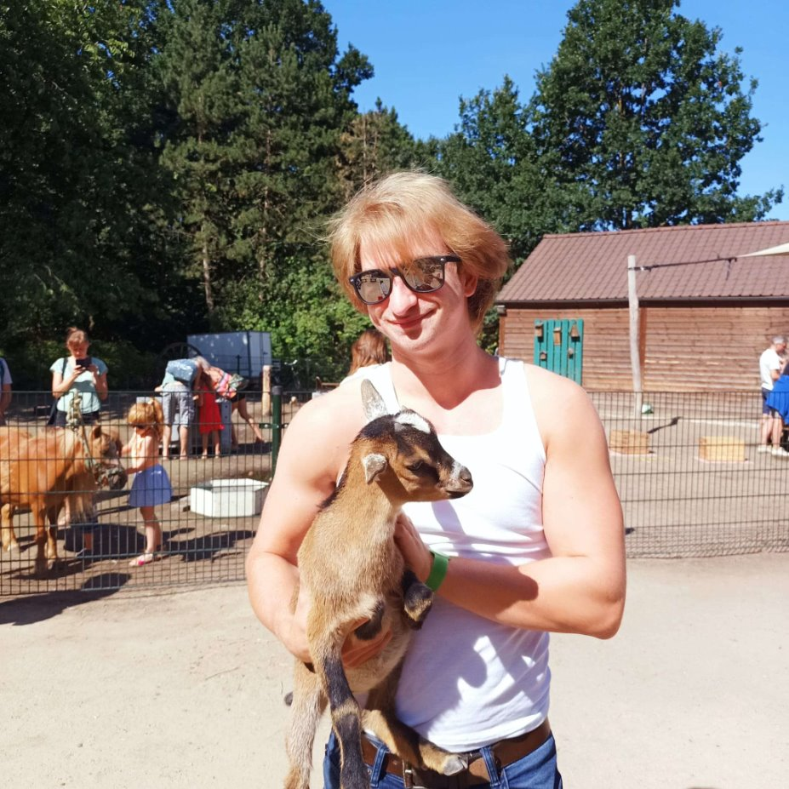

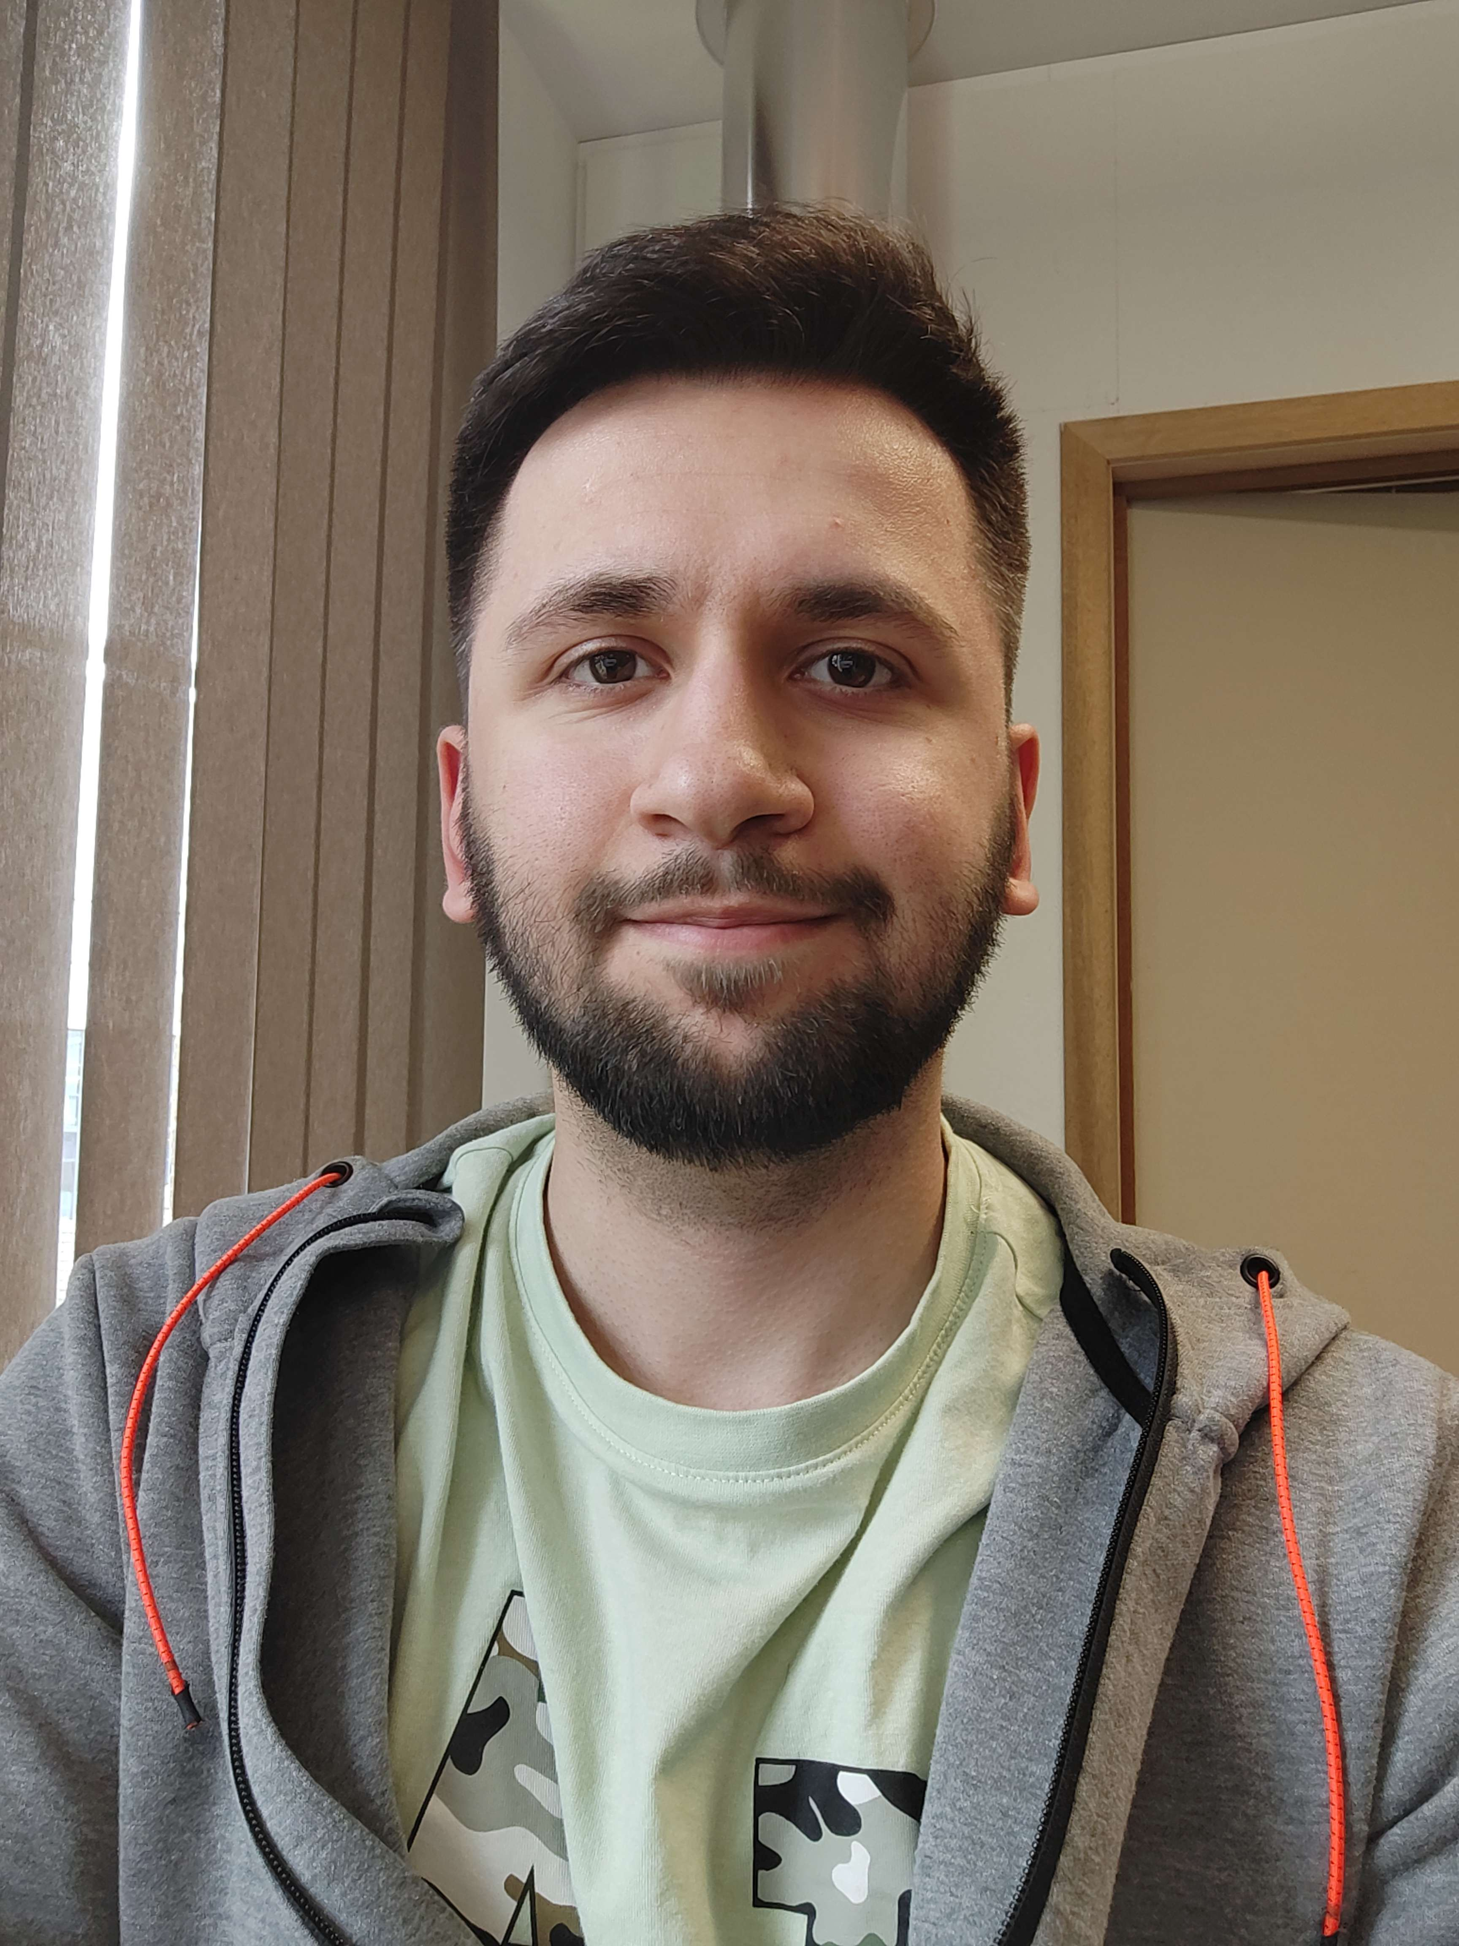

Samuel | Robin | Salih | Cisse

Slide 23
THANKS!
Do you have any questions?

